Slide 1
Single-Source 3D Optical Wireless Positioning
Kevin Jose ACUNA CONDORI
23/09/2026

Slide 2
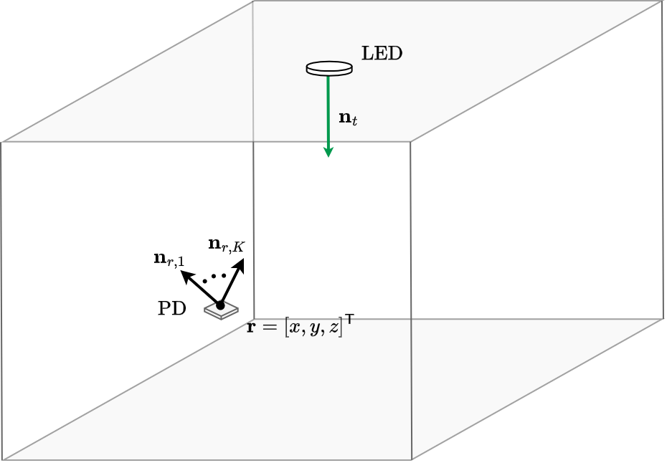
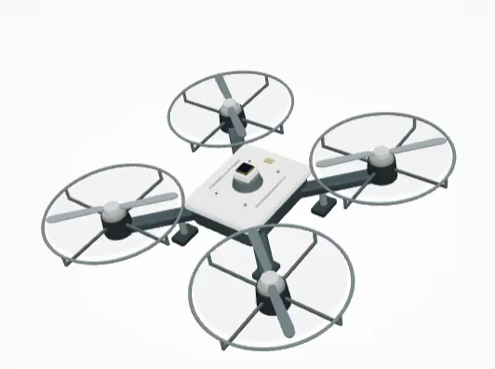
Sterable Receiver

Slide 3
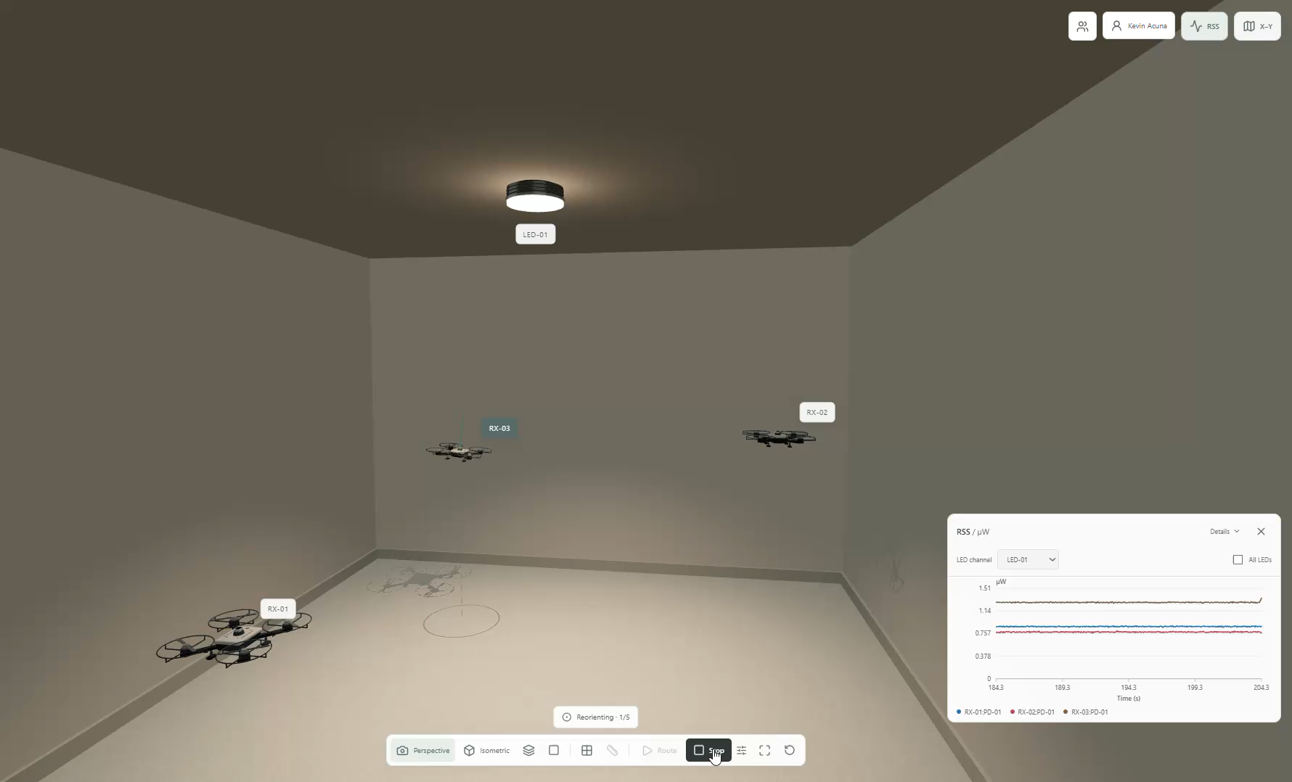

Slide 4
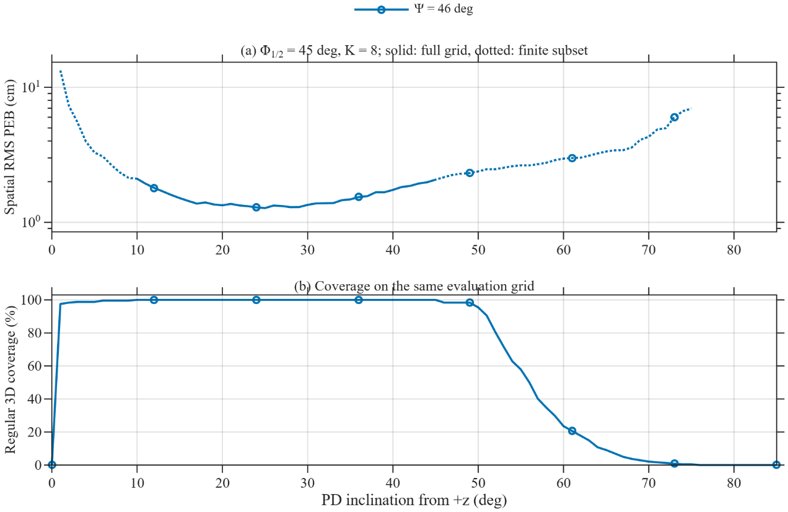

Slide 5
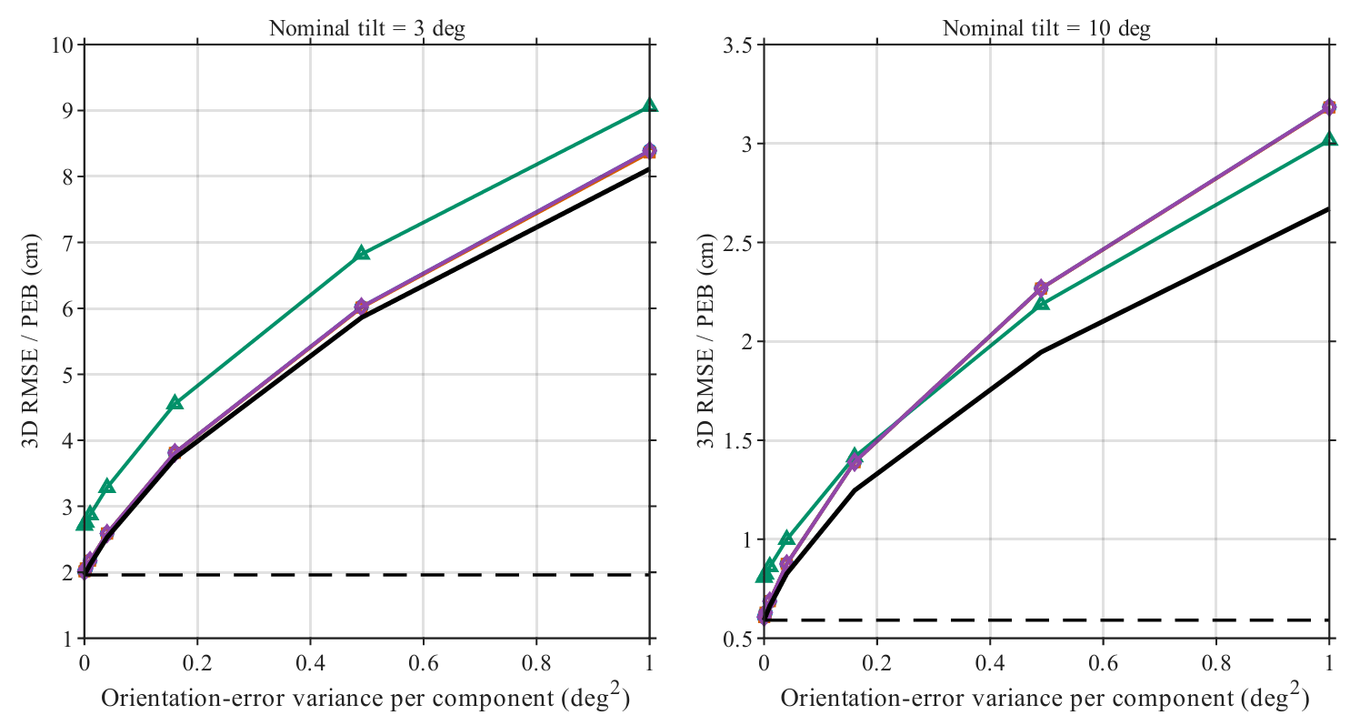

Slide 6
Preparation for the experiments

Slide 7
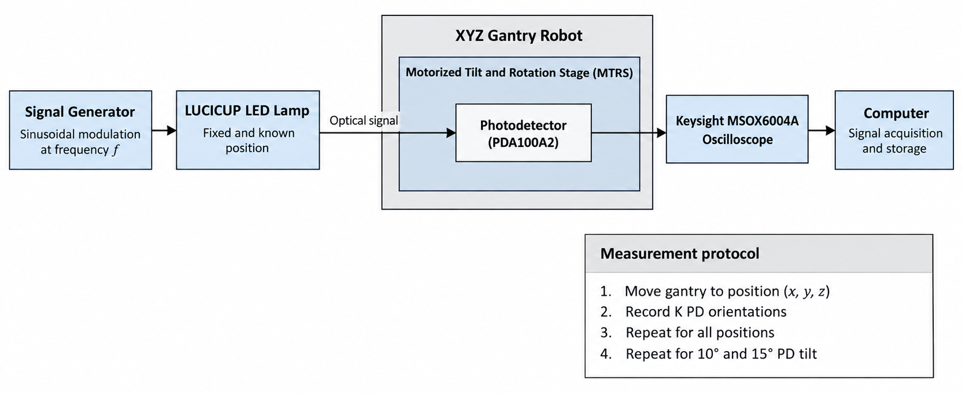

Slide 8
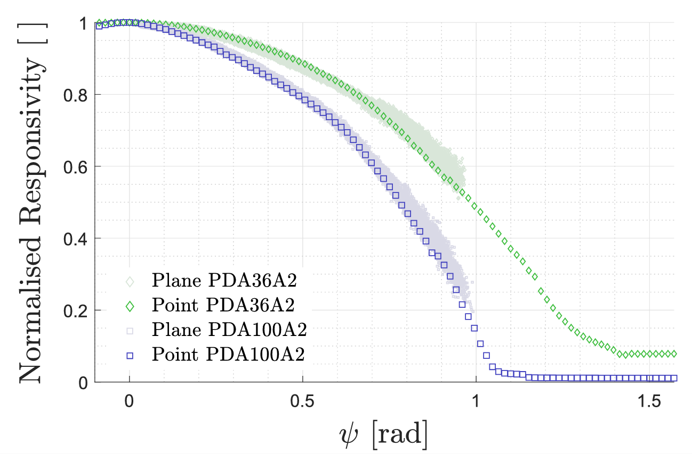
Characterization of the PD
Impact of a PD’s Angular Characteristics on RSS-Based VLP Accuracy

Slide 9
Thank you
Kevin Jose ACUNA CONDORI
17/09/2026

Slide 10
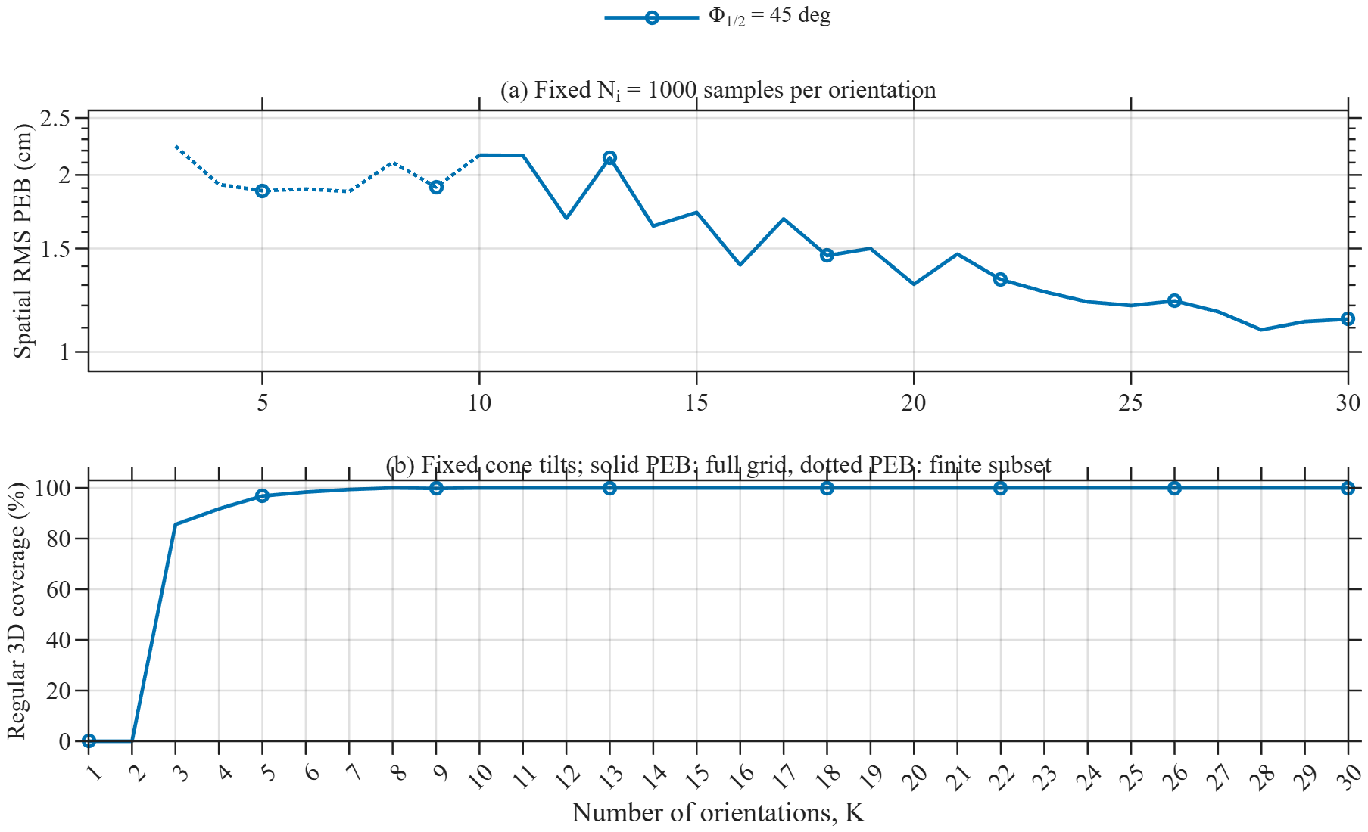
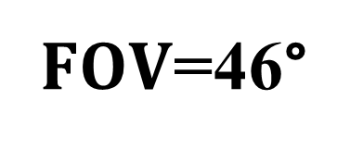
Tilt=10°
$FOV$=46°

